Slide 1

Virtual Keyboard
By Jake Risley
28/11/2023

Slide 2

Motivation
The motivation behind this project is to create a new kind of interaction between a person and their computer.

Slide 3

Background
About 75% of people who type daily suffer from wrist pain.
Prolonged use of a keyboard can lead to wrist and finger joint pain.
Can be harmful for people who suffer from long term joint conditions

Slide 4
Demonstration

Slide 5

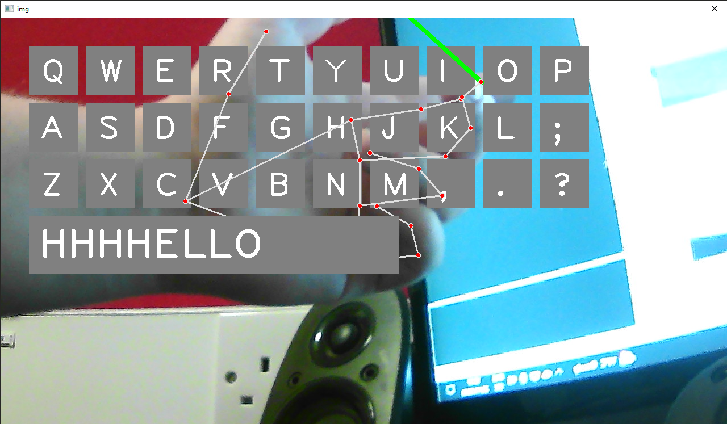
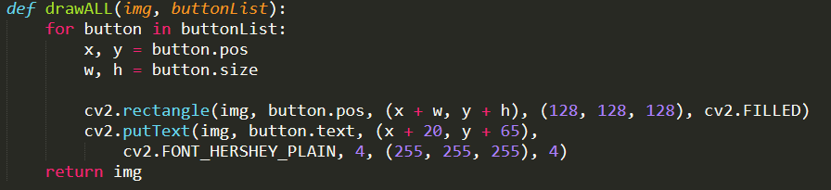
HOW IT WORKS

Slide 6
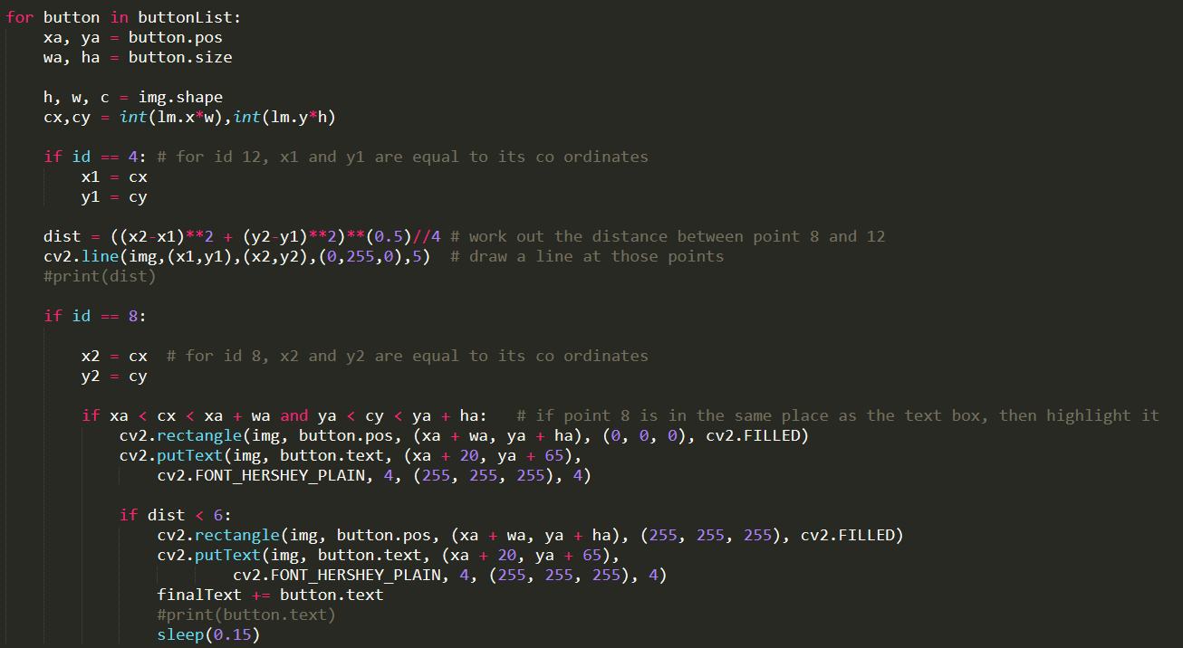

Slide 7

Key Findings / What can be Improved
Typing speed is very slow
Gets tiring very quickly
Limited set of characters

Slide 8

SUMMARY
Good concept except it will need to undergo a lot of changes to make it practical
Typing speed is way too slow
People may benefit from such a concept, but the target market would be very small

Slide 9

Future work
If I were to implement this into a future application
Change the way the user interacts with the interface
Include a way for the program to interact with the computer

Slide 10
THANK YOU
ANY QUESTIONS

